Slide 1


BAH Data Engineering Presentation
Team #4
Gamers
Members: Daniel Carter, Austin Rader, Lara Ek, Dave Patel
August 2022

Slide 2
TEAM 4: Project: Visualizing Video Game Data from Steam in an Azure Hosted Web Application
Our Official Project for the BAH Data Engineering Program
www.webagesolutions.com|1.877.517.6540

Slide 3




INTRODUCTIONS (replace this with your information)
Austin Radar Staff Engineer
Data Engineering TechEx Cohort
Lara Ek Staff Engineer
Data Engineering TechEx Cohort
Dave Patel Engineer
Data Engineering TechEx Cohort
Daniel Carter Engineer
Data Engineering TechEx Cohort

Slide 4
Project
Introductions
Project Overview
Architecture/Design diagram
Tools/Software Environment used
Challenges/Issues/Problems/Your stories
What have you learned/learned?
What else can we do on the project? - future plan- any design and implementation ideas?
Demo
Questions and answers
Azure hosted web application with database backend
www.webagesolutions.com|1.877.517.6540

Slide 5
Data Chosen for Project
Presented via recording by Lara Ek
Dataset from Steam with statistics on video games played on platform

Slide 6
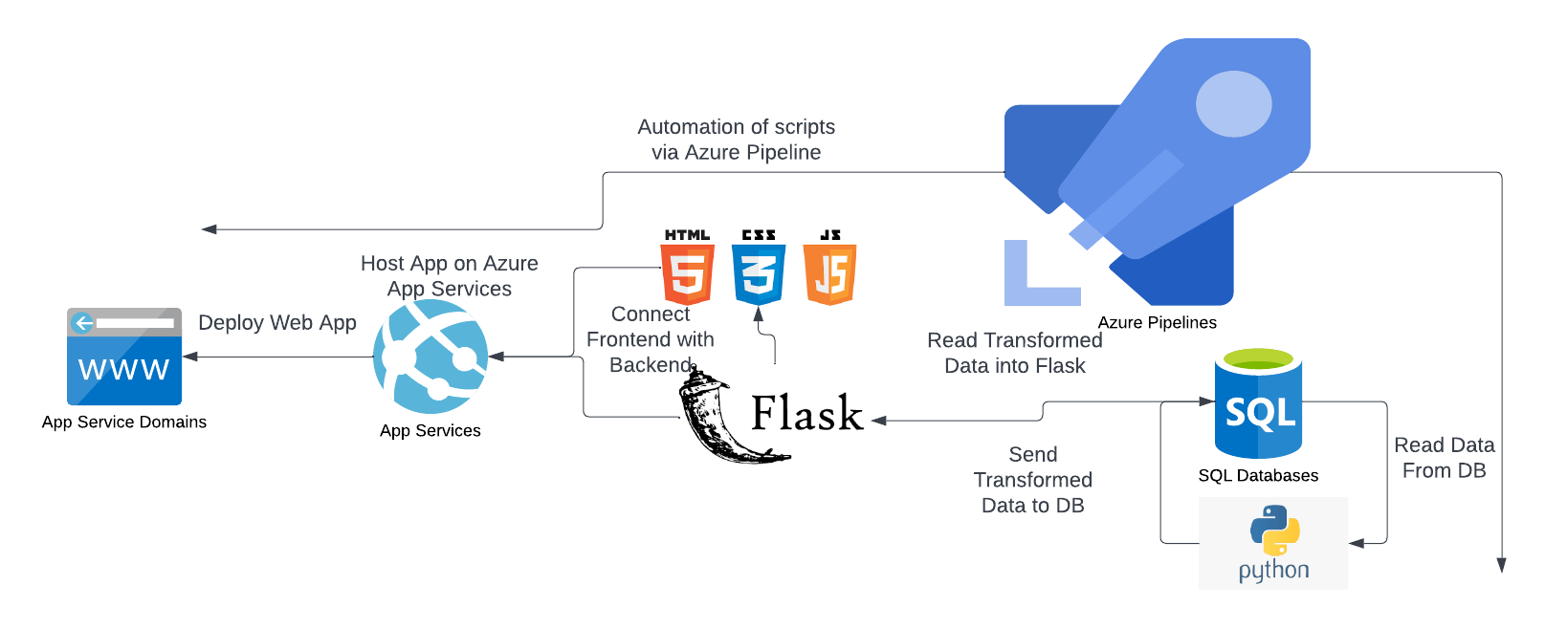
Architecture and Design

Slide 7
Technologies and Environment Used
Azure Pipelines
Azure SQL Server/Database
Python
Flask/HTML/CSS/JavaScript
Azure Web Hosting

Slide 8
Challenges and Issues
Issues
Challenges
Learning

Slide 9
Demo

Slide 10
Q & A
Questions?
Comments?

Slide 11
Thank you!!!
MARCH 2021

